Slide 1
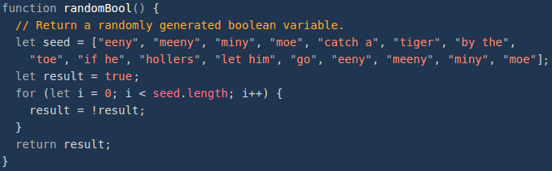

Slide 2
Functions + Objects/Classes
Zybooks – Chapter 7

Slide 3
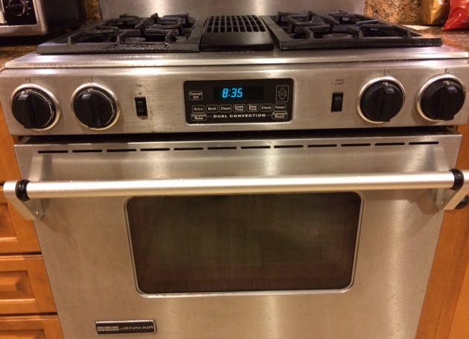
Objects/Classes
Object – internal data items plus operations that can be performed on that data.
Zybooks Example: Oven
Data:
Temperature
Material List
Time
Operations:
Put Something In Take something out Set Time
Get Time
Set Timer
…

Slide 4

Objects/Classes
Object – internal data items plus operations that can be performed on that data.
My Example: Pokemon
Data:
species
name
category
type(s)
stats
weaknesses
…
Operations:
evolve
attack 1 2 …
lower hp

Slide 5

Objects/Classes
Pokemon Object Example:
Data:
No.: 001
Name: Bulbasaur
Level: 4
Type: “Grass” ,“Poison”
Weaknesses: “Fire”, “Flying”, “Ice”, “Psycic”
Stats:
HP – 2
Attack – 3
Defense – 2
Special Attack - 3

Slide 6
Objects/Classes
Pokemon Object Example: (http://www.pokemon.com/us/pokedex/bulbasaur)
Data:
Attack 1 Name– “Tackle”
Attack 2 Name– “Growl”
Attack 3 Name– “”
Operations:
Increase Experience
Attack1
Attack2
…

Slide 7
Objects/Classes
Class – defines a new type that can group data and functions to form an object
Usage:
Programmer Defined variable of a class type as a global variable, in main, or another function.
string name;
Multiple variables from single class type
Call member functions (Typically set to Public):
name.length();
NOTE: (.) operator used to access member functions

Slide 8
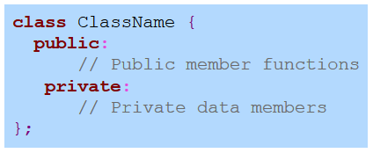
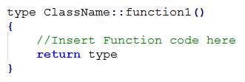
Objects/Classes
Construction of classes:
Construction of member function
Scope resolution operator (::)
Class Type
Privacy Designators
Mandatory Semicolon

Slide 9
Objects/Classes
Mutator/Acessor
Mutator – a function that modifies (“mutates”) the class’ data members
Accessor – a function that access the data members BUT does not modify them
Names of functions usually imply Mutator or Accessor

Slide 10
Objects/Classes
Member, Mutator, or Accessor
class GamePlay{
public:
void setPlayerA(int playScore);
int getPlayerA();
Private:
int MaxOfPair();
int PlayerA;
int PlayerB;
};

Slide 11
Objects/Classes
Member, Mutator, or Accessor
class GamePlay{
public:
void setPlayerA(int playScore); MUTATOR
int getPlayerA();
Private:
int MaxOfPair();
int PlayerA;
int PlayerB;
};

Slide 12
Objects/Classes
Member, Mutator, or Accessor
class GamePlay{
public:
void setPlayerA(int playScore); MUTATOR
int getPlayerA(); ACCESSOR
Private:
int MaxOfPair();
int PlayerA;
int PlayerB;
};

Slide 13
Objects/Classes
Member, Mutator, or Accessor
class GamePlay{
public:
void setPlayerA(int playScore); MUTATOR
int getPlayerA(); ACCESSOR
Private:
int MaxOfPair(); ACCESSOR
int PlayerA;
int PlayerB;
};

Slide 14
Objects/Classes
Member, Mutator, or Accessor
class GamePlay{
public:
void setPlayerA(int playScore); MUTATOR
int getPlayerA(); ACCESSOR
Private:
int MaxOfPair(); ACCESSOR
int PlayerA; MEMBER
int PlayerB;
};

Slide 15
Objects/Classes
Member, Mutator, or Accessor
class GamePlay{
public:
void setPlayerA(int playScore); MUTATOR
int getPlayerA(); ACCESSOR
Private:
int MaxOfPair(); ACCESSOR
int PlayerA; MEMBER
int PlayerB; MEMBER
};

Slide 16
Objects/Classes
Constructors – A way of initializing a members at the declaration of an object.
Constructor – a member function for initialization
Has the same name as the class.
No return type
Must be included in the class definition

Slide 17
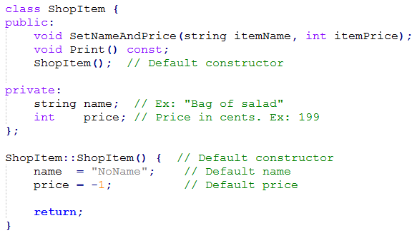
Object/Classes
Constructors

Slide 18
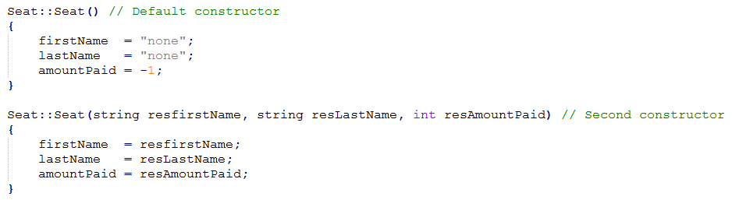
Object/Classes
Constructors – overloading
Just like overloading functions - must be differentiated by the parameters of the function

Slide 19
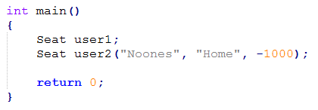
Object/Classes
Constructors – How to use them
Calls default Constructor
Calls Overloaded Constructor

Slide 20
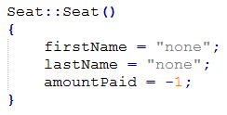

Object/Classes
Constructors: Member initialization – Alternate Approach

Slide 21
Object/Classes
Constructors: Member initialization – Alternate Approach
Mandatory Colon
Separated by Commas

Slide 22
Object/Classes
Implicit parameter
Member functions called using object.Function()
Compiler takes this and converts it to a function call
object.Function(...) becomes Function(object, ...)
The object is known as an Implicit Parameter

Slide 23
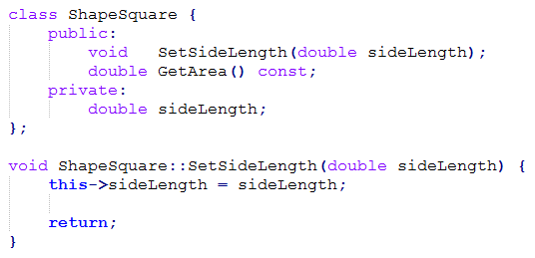
Object/Classes
this – accesses the implicitly passed object pointer
this→ member - The way a member can be access implicitly
Class Member
Parameter

Slide 24
Object/Classes
Understanding this->member
Given a class Spaceship with a private data member numYears and public member function
void Spaceship::AddNumYears(int numYears)
In AddNumYears(), which would set data member numYears to 0 using implicit parameter?
numYears = 0;
this.numYears = 0;
this-> numYears = 0;

Slide 25
Object/Classes
Understanding this->member
Given a class Spaceship with a private data member numYears and public member function
void Spaceship::AddNumYears(int numYears)
In AddNumYears(), which would set data member numYears to 0 using implicit parameter?
numYears = 0
this.numYears = 0;
this-> numYears = 0;

Slide 26
Object/Classes
Understanding this->member
Given a class Spaceship with a private data member numYears and public member function
void Spaceship::AddNumYears(int numYears)
In AddNumYears(), which would assign the parameter numYears to the data member numYears using implicit parameter?
numYears = this->numYears;
this->numYears = numYears;

Slide 27
Object/Classes
Understanding this->member
Given a class Spaceship with a private data member numYears and public member function
void Spaceship::AddNumYears(int numYears)
In AddNumYears(), which would assign the parameter numYears to the data member numYears using implicit parameter?
numYears = this->numYears;
this->numYears = numYears;

Slide 28
Object/Classes
Understanding this->member
Given a class Spaceship with a private data member numYears and public member function
void Spaceship::AddNumYears(int numYears)
In AddNumYears(), which would add the parameter numYears to the existing value value of data member numYears using implicit parameter?
this->numYears = this->numYears +numYears;
this->numYears = numYears +numYears;
Not Possible

Slide 29
Object/Classes
Understanding this->member
Given a class Spaceship with a private data member numYears and public member function
void Spaceship::AddNumYears(int numYears)
In AddNumYears(), which would add the parameter numYears to the existing value value of data member numYears using implicit parameter?
this->numYears = this->numYears +numYears;
this->numYears = numYears +numYears;
Not Possible

Slide 30
Object/Classes
Understanding this->member
Given a class Spaceship with a private data member numYears and public member function
void Spaceship::AddNumYears(int numYears)
In main(), given variable definition: Spaceship ss1, which sets ss1’s numYears to 5 using implicit parameter?
ss1.numYears = 5;
ss1->numYears = 5;
this->numYears =5;
None of the above

Slide 31
Object/Classes
Understanding this->member
Given a class Spaceship with a private data member numYears and public member function
void Spaceship::AddNumYears(int numYears)
In main(), given variable definition: Spaceship ss1, which sets ss1’s numYears to 5 using implicit parameter?
ss1.numYears = 5;
ss1->numYears = 5;
this->numYears =5;
None of the above

Slide 32
Object/Classes
Understanding this->member
Complete the code to assign the value minutes to data member minutes using this-> notation?
Void ElapsedTime::SetMinutes(int minutes){
this->minutes = minutes;
return;
}

Slide 33
Object/Classes
Understanding this->member
Complete the code to assign the value minutes to data member minutes using this-> notation?
Void ElapsedTime::SetMinutes(int minutes){
this->minutes = minutes;
return;
}

Slide 34
Object/Classes
Understanding this->member
Complete the code to assign the value minutes to data member minutes using this-> notation?
Void ElapsedTime::SetHours(int minutes){
this->hours = hours;
return;
}

Slide 35
Object/Classes
Understanding this->member
Complete the code to assign the value minutes to data member minutes using this-> notation?
Void ElapsedTime::SetHours(int minutes){
this->hours = hours;
return;
}

Slide 36
Object/Classes
Abstract data type (ADT) – a data type whose creation and update are constrained to specific well-defined operations.
KEY: Information Hiding (Encapsulation)
Use of Private and Public
Allows user to focus on higher level concepts
Allows Developers to improve and modify internal implementation without changes to the programs using the ADT.

Slide 37
Object/Classes
Abstract data types (ADT) - EXAMPLES
Queue
(FIFO)
Item 3
Item 2
Item 1

Slide 38
Object/Classes
Abstract data types (ADT) - EXAMPLES
Queue
(FIFO)
Item 4
push
Item 3
Item 2
Item 1

Slide 39
Object/Classes
Abstract data types (ADT) - EXAMPLES
Queue
(FIFO)
Item 4
Item 3
Item 2
Item 1

Slide 40
Object/Classes
Abstract data types (ADT) - EXAMPLES
Queue
(FIFO)
Item 4
Item 3
Item 2
pop
Item 1

Slide 41
Object/Classes
Abstract data types (ADT) - EXAMPLES
Stack
(LIFO)
Item 3
Item 2
Item 1

Slide 42
Object/Classes
Abstract data types (ADT) - EXAMPLES
Stack
(LIFO)
Item 4
push
Item 3
Item 2
Item 1

Slide 43
Object/Classes
Abstract data types (ADT) - EXAMPLES
Stack
(LIFO)
Item 4
Item 3
Item 2
Item 1

Slide 44
Object/Classes
Abstract data types (ADT) - EXAMPLES
Stack
(LIFO)
pop
Item 4
Item 3
Item 2
Item 1

Slide 45
Object/Classes
Unit Testing – Testing your code to make sure it works
Testbench – a special program developed to test a written class
Good Practices:
Create a testbench to automatically check for correct execution
Don’t print out Successes, print out Failures
Keep test independent from the previous case as much as possible (Different values in test)
Code Coverage: All code is executed at least once

Slide 46
Methods
Method – a member function of a class
Constructors – a method that runs at the declaration of an object (instance of a class) automatically that initializes member variables.
THINGS THAT HAVE TO BE DONE BEFORE AN OBJECT IS USED
Destructors – a method that runs at the end of a program that “finalizes” an object
THINGS THAT HAVE TO BE DONE BEFORE AN OBJECT IS DELETED

Slide 47
Methods
Destructors – called at the program termination
return in main
exit
abort
Writing Destructors
className::~className()
{
// Does things
}

Slide 48
Methods
Writing other methods for classes
int className::function1()
{
// Does some stuff (Follows Rules on Functions)
return someValue;
}

Slide 49
Methods
Writing other methods for classes
int className::function1()
{
// Does some stuff (Follows Rules on Functions)
return someValue;
}
Function Name
Class Name
Return Type: Returned value and return tag must match

Slide 50
Methods
Using methods – dot operator ( . )
className object1;
int value = object1.function1();
Using methods within the class – this->
int value = this->function1();

Slide 51
Methods
Access methods – get or set private variables
Hides data implementation details
Access to variables through an interface keeps backward compatability
Getters – returns the value you want
Setters – take a value in parameter to set to member

Slide 52
Methods
Utility methods – declared as private methods
Known as helper methods
Helps access methods process data
Validation of data
Processing data before returned to other code
Encapsulates a class behavior
Hides implementation detail
Not accessible to code outside of class

Slide 53
Namespaces
Namespaces – a group of variables, classes, objects, and other functions under one name
“One of C++’s less heralded additions is adition of namespaces”
- Alex Allain (cprogramming.com)
Format:
namespace identifier
{
entities
}

Slide 54
Namespaces
Namespaces – a group of variables, classes, objects, and other functions under one name
“One of C++’s less heralded additions is adition of namespaces”
- Alex Allain (cprogramming.com)
Format:
namespace identifier
{
entities
}
The alias for the namespace
Set of variables, classes, objects and functions

Slide 55
Namespaces
Accessing entities of a namespace - ::
Assuming
namespace myNamespace
{
int a,b;
}
To access the integers a and b from myNamespace
myNamespace::a
myNamespace::b

Slide 56
Namespaces
Accessing entities of a namespace - ::
Assuming
namespace myNamespace
{
int a,b;
}
To access the integers a and b from myNamespace
myNamespace::a
myNamespace::b
Qualifier
Entity

Slide 57
Namespaces
Accessing entities of a namespace - ::
Accessing works both ways
Setting variables with a namespace entity
int variable = myNamespace::a;
Setting namespace entities with variables
myNamespace::b = variable;

Slide 58
Namespaces
using – keyword that allows the use of namespace entities within a scope. Can use namespace entities without :: operator
Using our previous example of myNamespace
using namespace myNamespace;
a =3;
b = a;

Slide 59
Namespaces
using – keyword that allows the use of namespace entities within a scope. Can use namespace entities without :: operator
Using our previous example of myNamespace
using namespace myNamespace;
a =3;
b = a;
Setting value to entity
Using entity to set a variable (or other entity)

Slide 60
Namespaces
Where things get complicated: Namespaces can have entities that share names.
Namespace first
{
int x = 3;
int y = 4;
}
Namespace second
{
double x = 3.0;
double y = 4.0;
}

Slide 61
Namespaces
Where things get complicated: Namespaces can have entities that share names.
int main()
{
using namespace first;
using namespace second;
x = 1;
cout << x << endl
}

Slide 62
Namespaces
Where things get complicated: Namespaces can have entities that share names.
int main()
{
using namespace first;
using namespace second;
x = 1;
cout << x << endl
}
Error: reference is ambiguous

Slide 63
Namespaces
Where things get complicated: Namespaces can have entities that share names.
Method one: add qualifiers
int main()
{
using namespace first;
using namespace second;
second::x = 1;
cout << first::x << endl
}
Adding qualifiers helps designate which entities you are referring to

Slide 64
Namespaces
Where things get complicated: Namespaces can have entities that share names.
Method two: Set Scope
int main()
{
{
using namespace second;
x = 1;
}
{
using namespace first;
cout << x << endl
}
}
Use of { } sets the scope for the namespace. Doesn’t need Qualifiers

Slide 65
Namespaces
Namespace alias: Alternate name to a namespace
namespace new_name = current_name;

Slide 66
Namespaces
Why?
A way to structure your program into logical units
Division of labor
Group Project you are trying to bring together

Slide 67
Namespaces - Questions
A namespace helps avoid name conflicts among classes, functions, and other items in a large program
TRUE or FALSE

Slide 68
Namespaces - Questions
A namespace helps avoid name conflicts among classes, functions, and other items in a large program
TRUE or FALSE

Slide 69
Namespaces - Questions
Standard library classes, functions, etc., are part of a namespace named std.
TRUE or FALSE

Slide 70
Namespaces - Questions
Standard library classes, functions, etc., are part of a namespace named std.
TRUE or FALSE

Slide 71
Namespaces - Questions
The line using namespace std; is required in any program.
TRUE or FALSE

Slide 72
Namespaces - Questions
The line using namespace std; is required in any program.
TRUE or FALSE

Slide 73
Namespaces - Questions
Without using namespace std; a programmer can access cout via the notation std::cout
TRUE or FALSE

Slide 74
Namespaces - Questions
Without using namespace std; a programmer can access cout via the notation std::cout
TRUE or FALSE

Slide 75
Namespaces - Questions
Without any using namespace ____ line, if the compiler sees cout << num1, the compiler automatically checks in the standard library namespace for cout.
TRUE or FALSE

Slide 76
Namespaces - Questions
Without any using namespace ____ line, if the compiler sees cout << num1, the compiler automatically checks in the standard library namespace for cout.
TRUE or FALSE

